Slide 1
ARTIFICIAL INTELLIGENCE Week 3
Dr. Momina Moetesum

Slide 2
Informed (Heuristic) Search
Informed searches use domain knowledge to guide selection of the best path to continue searching
Heuristics are used, which are informed guesses
Heuristic means "serving to aid discovery“
Best-first search (for small search spaces)
Greedy best-first search
A* search
Iterative Deepening A*
Local search algorithms (for large search spaces)
Hill-climbing search
Simulated annealing search
Local beam search
Genetic algorithms

Slide 3
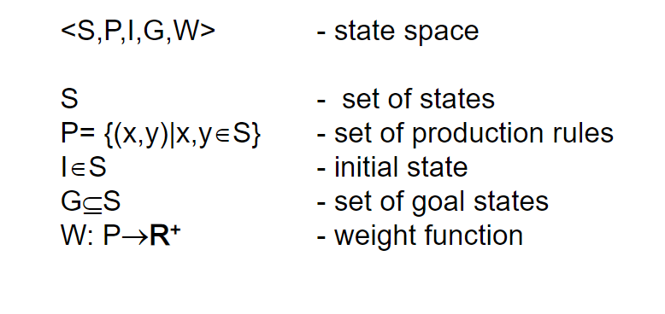
State Space

Slide 4
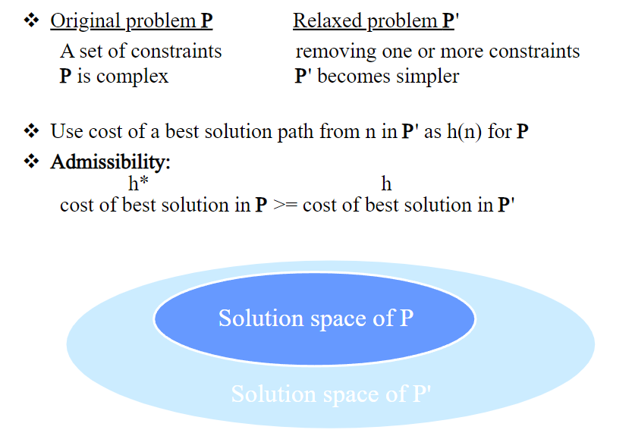
Relaxed Problem

Slide 5
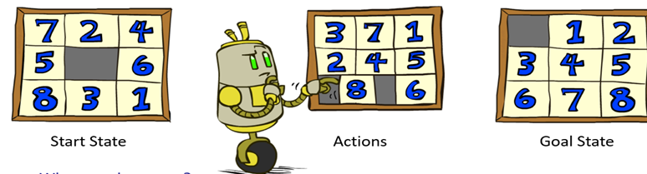
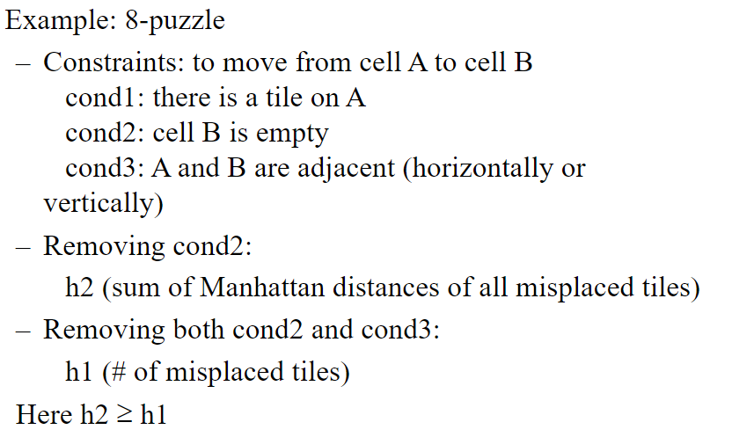
Example: 8-Puzzle

Slide 6
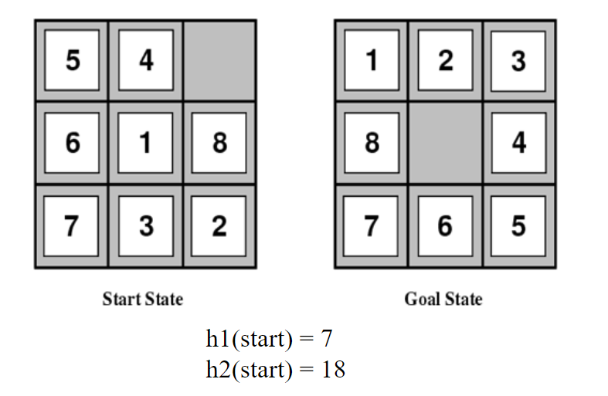
Example: 8-Puzzle
Dominance of a Heuristic:
If h1(n) ≤ h2(n) ≤ h*(n) for all n, then h2 dominates h1
h2 is a better heuristic than h1

Slide 7
Dominance
If h1(n) ≤ h2(n) ≤ h*(n) for all n, then h2 dominates h1
h2 is a better heuristic than h1
A* using h1 (i.e., A1*) expands at least as many if not more nodes than using A* with h2 (i.e., A2*)
A2* is said to be better informed than A1*
Typical search costs (average number of nodes expanded):
d=12
IDS = 3,644,035 nodes
A * (h1 ) = 227 nodes
A * (h2 ) = 73 nodes
d=24
IDS = out of memory
A * (h1 ) = 39,135 nodes
A * (h2 ) = 1,641 nodes

Slide 8
Local Search versus Systematic Search
Local Search
Hill Climbing Search, Simulated Annealing, Local beam search and Genetic Algorithms etc
Does not keep history of visited nodes
Good for identifying candidate solutions

Slide 9
Local search algorithms
In many optimization problems, the path to the goal is irrelevant; the goal state itself is the solution
State space = set of "complete" configurations (all possible solutions)
In such cases, we can use local search algorithms
keep a single "current" state and gradually try to improve it

Slide 10
Local Search
Previously, state space was searched and recorded from start to end state until path to a solution is found, but what if in a problem path is irrelevant.
In n-queens problem, what matters is final configuration of queens, not the order in which they are added.
Others include travelling salesperson, job scheduling, vehicle routing etc.
In many optimization problems, the path to the goal is irrelevant; the goal state itself is the solution.
Examples:
to reduce conflicts, as in n-queens

Slide 11
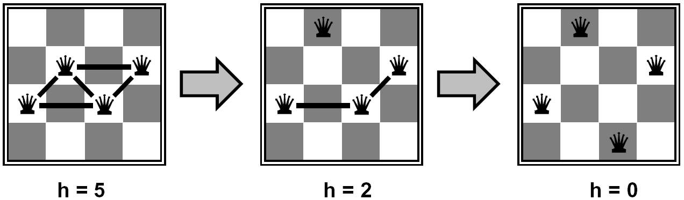
N-Queens Problem
Put n queens on an n × n board with no two queens on the same row, column, or diagonal
State space: all possible n-queen configurations
What’s the objective function? – Number of pairwise conflicts
Start wherever, move queens to reduce conflicts
Almost always solves large n-queens nearly instantly

Slide 12
Local Search and Optimization
Local search
Keep track of single current state
Move only to neighboring states
Ignore paths
Advantages
Use very little memory
Can often find reasonable solutions in large or infinite (continuous) state spaces.

Slide 13
Local Search and Optimization
Useful for solving pure optimization problems
find the best state according to some objective function.
objective function tells us how “good” a given state is,
we want to find the solution (goal) by minimizing or maximizing the value of this function

Slide 14
Application of Local search algorithms
There are many important applications of local search algorithms such as:
integrated-circuit design,
factory floor layout,
job shop scheduling,
telecommunication network optimization,
vehicle routing

Slide 15
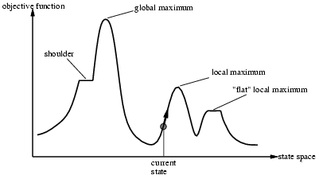
Local Search Algorithms
Consider state space landscape
A landscape has both “location” and “elevation”.
If elevation corresponds to cost, then the aim is to find the lowest valley- a global minimum
If elevation corresponds to an objective function, then the aim is to find the highest peak- a global maximum.

Slide 16
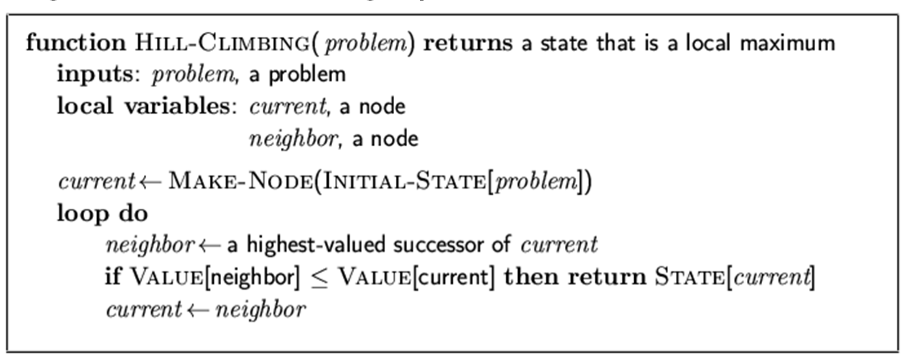
Hill Climbing Search
HC exploits the neighborhood
like Greedy Best-First search, it chooses what looks best locally
doesn't allow backtracking or jumping to an alternative path since there is no Frontier list
It evaluates the current state with next states (whether it is better or not)
Current node is replaced by the best
successor (if it is better than current node)

Slide 17
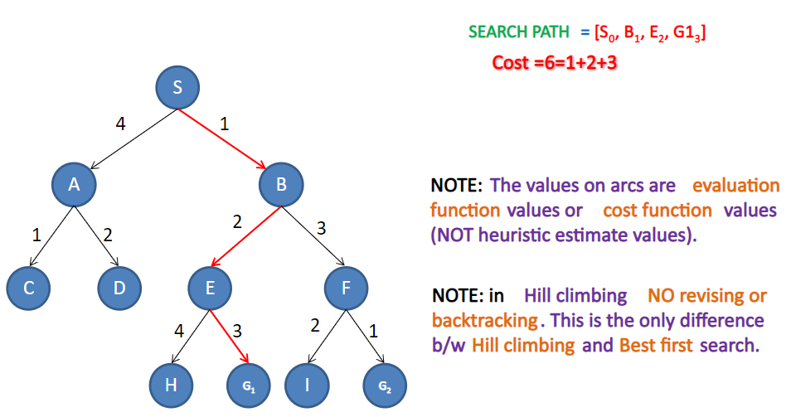
Tree Example

Slide 18
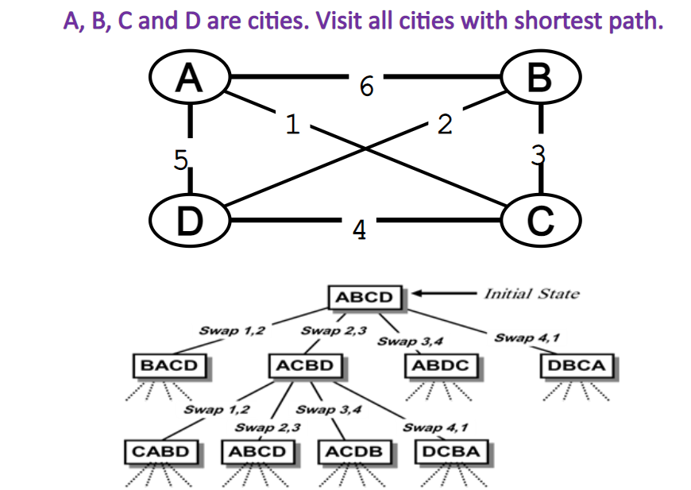
Traveling Salesman Problem

Slide 19
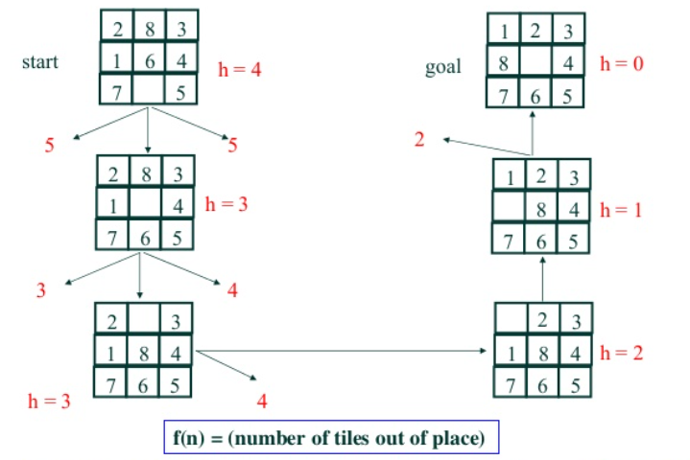
8-Puzzle Example

Slide 20
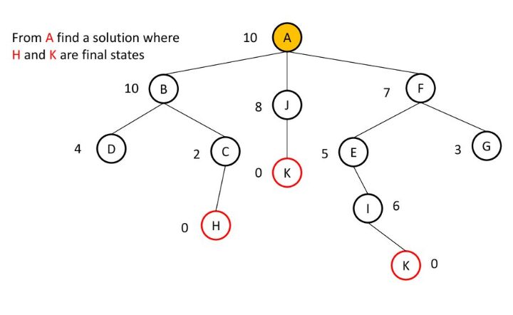
Hill Climbing Search and Local Maxima

Slide 21
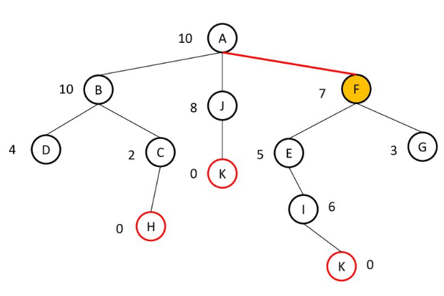
Hill Climbing Search and Local Maxima

Slide 22
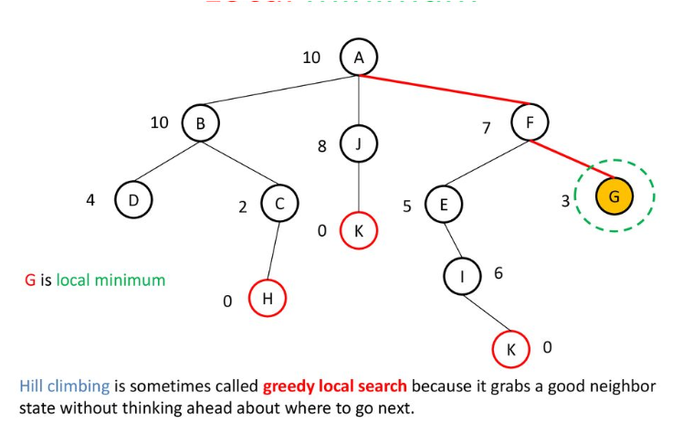
Hill Climbing Search and Local Maxima

Slide 23
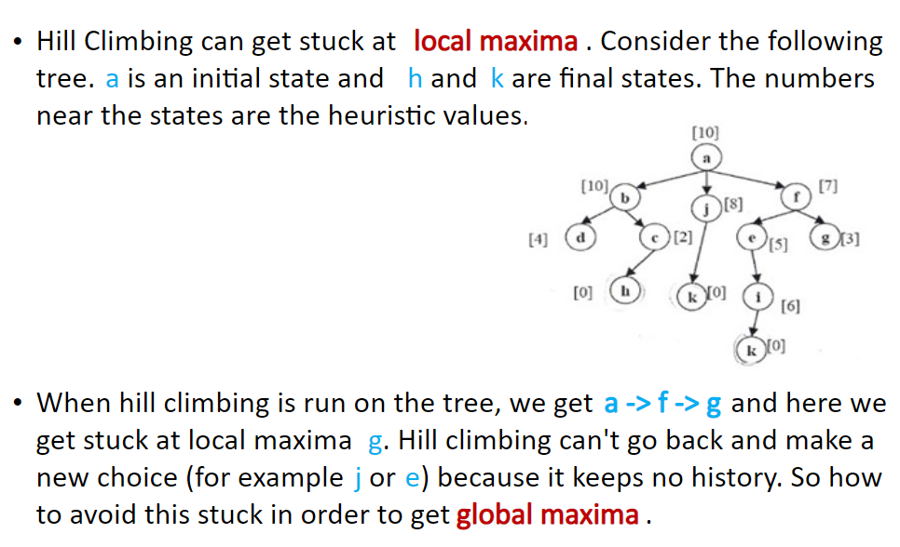

Local Maxima Issue

Slide 24
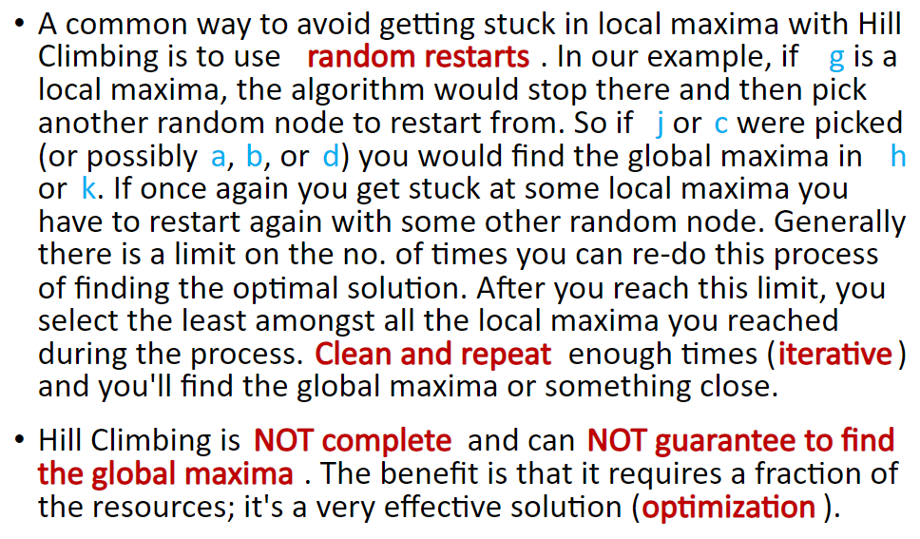
Local Maxima Issue

Slide 25
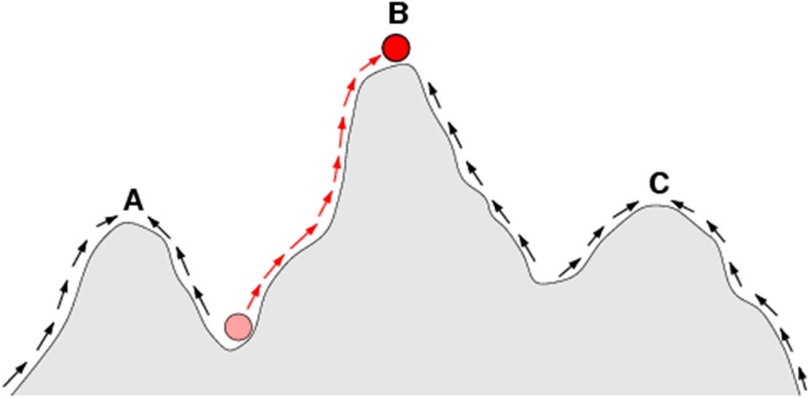
Hill climbing and local maxima
When local maxima exist, hill climbing is suboptimal
Simple (often effective) solution
Multiple random restarts
Optimal when starting in one of these states

Slide 26
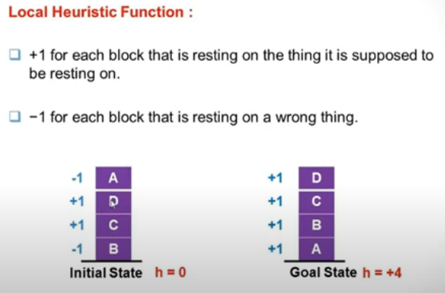
Block World Example using Local Heuristic

Slide 27
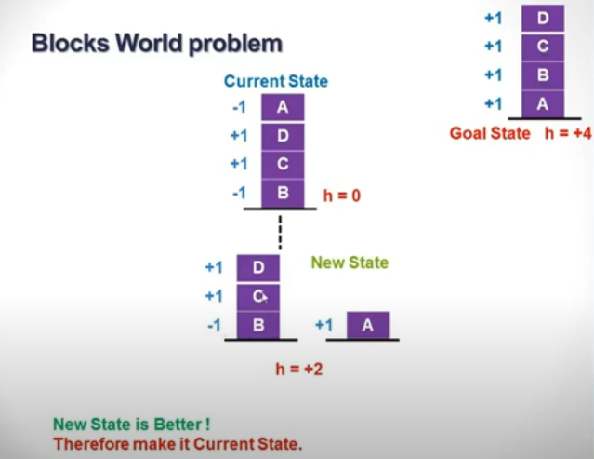
Block World Example using Local Heuristic

Slide 28
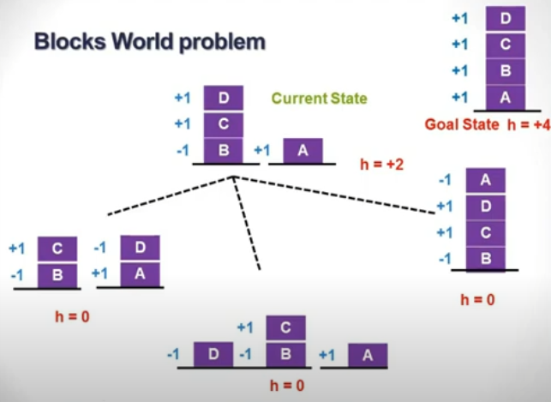
Block World Example using Local Heuristic

Slide 29
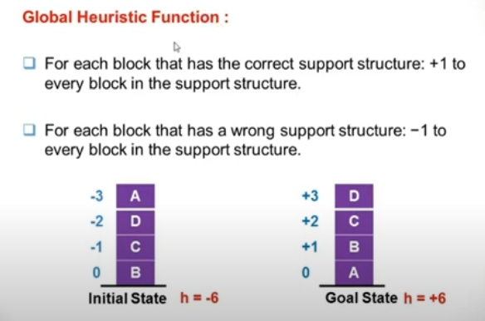
Block World Example using Global Heuristic

Slide 30
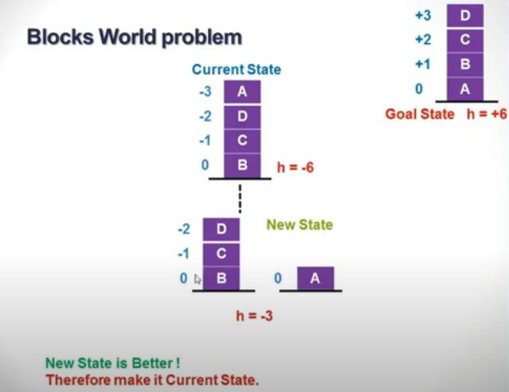
Block World Example using Global Heuristic

Slide 31
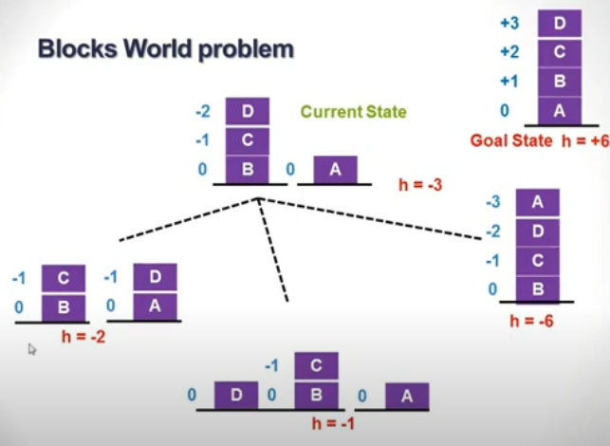
Block World Example using Global Heuristic

Slide 32
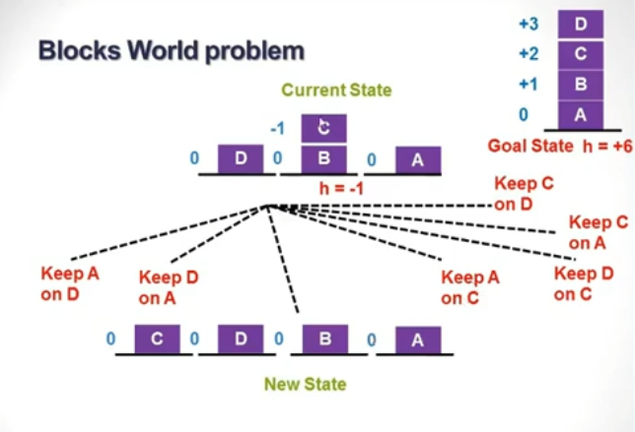
Block World Example using Global Heuristic

Slide 33
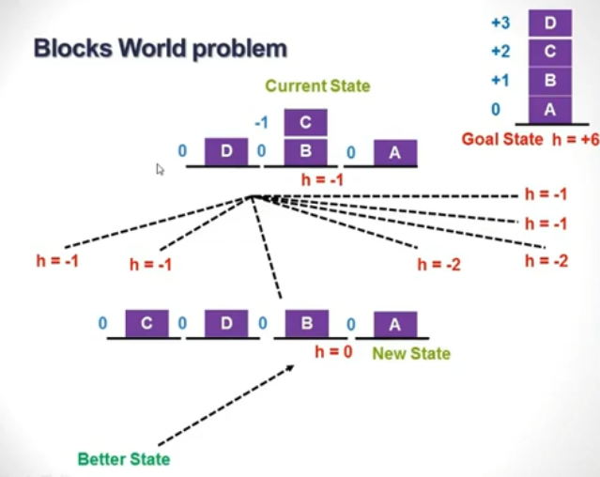
Block World Example using Global Heuristic

Slide 34
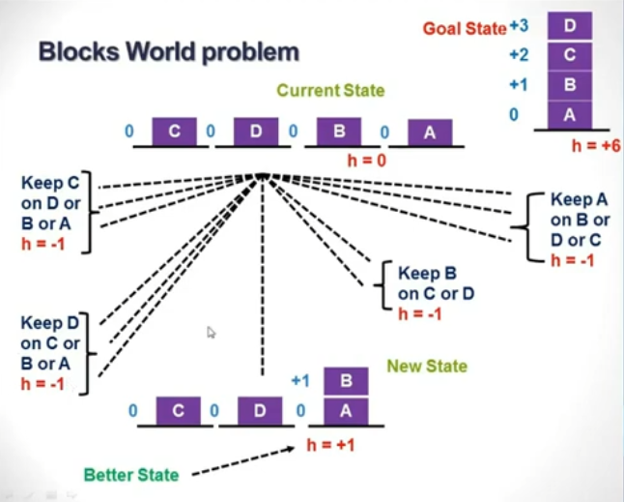
Block World Example using Global Heuristic

Slide 35
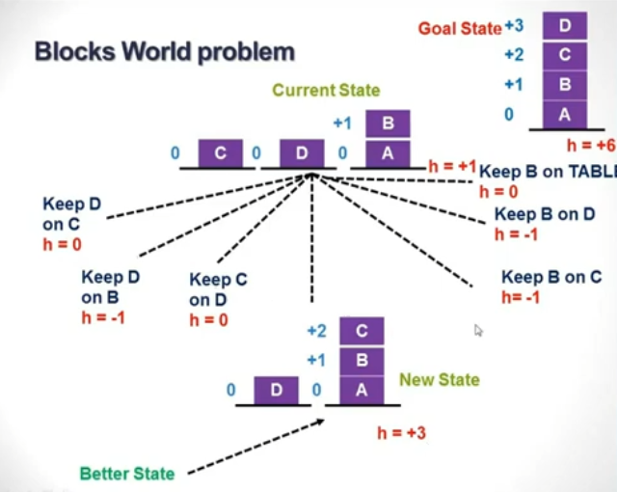
Block World Example using Global Heuristic

Slide 36
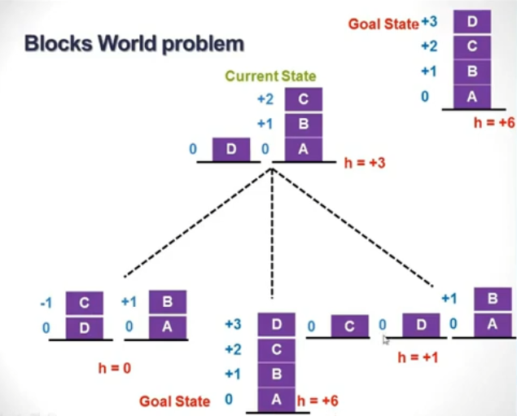
Block World Example using Global Heuristic

Slide 37
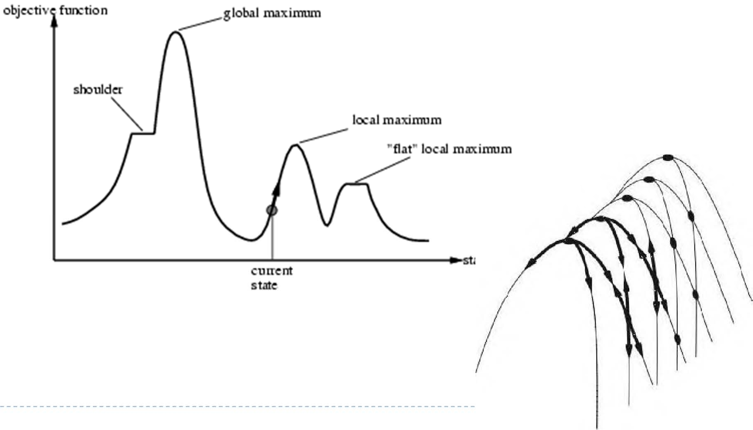
Hill-climbing search problems
Local maxima: a peak that is not global max
Plateau: a flat area (flat local max, shoulder)
 Ridges: a sequence of local max that is very difficult for greedy algorithm to navigate (chain of mountains)

Slide 38
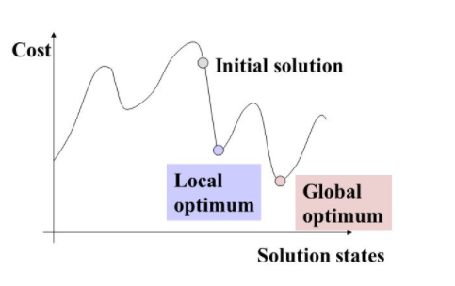
Simulated Annealing
Simulated Annealing (SA) allows downward steps.
It checks all the neighbours.
Origin:
It is a process of metallurgy where metals are slowly cooled to make them reach a state of low energy where they are strong.
Intuition:
By allowing occasional ascent in the search process, we might be able to escape the traps of local minima

Slide 39
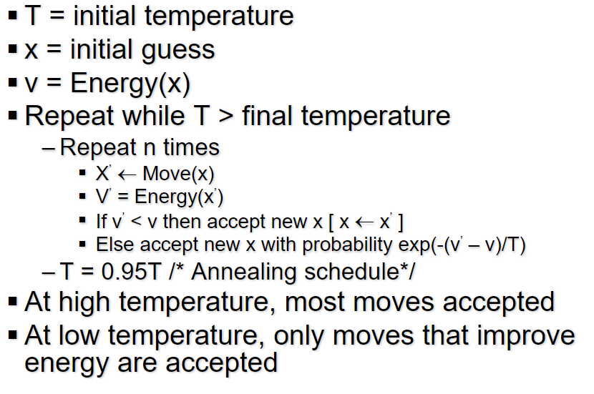
Simulated Annealing

Slide 40
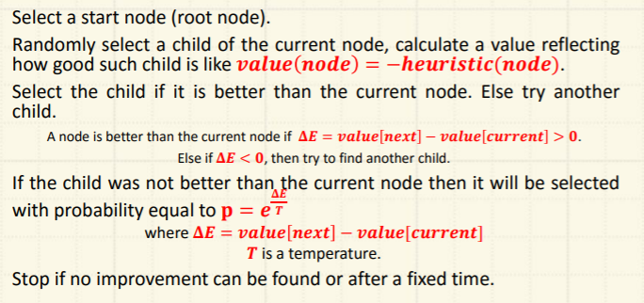
Simulated Annealing Steps

Slide 41
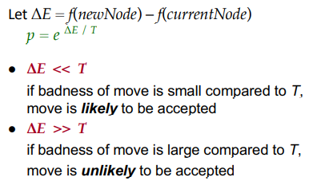
Escaping Local Maxima

Slide 42
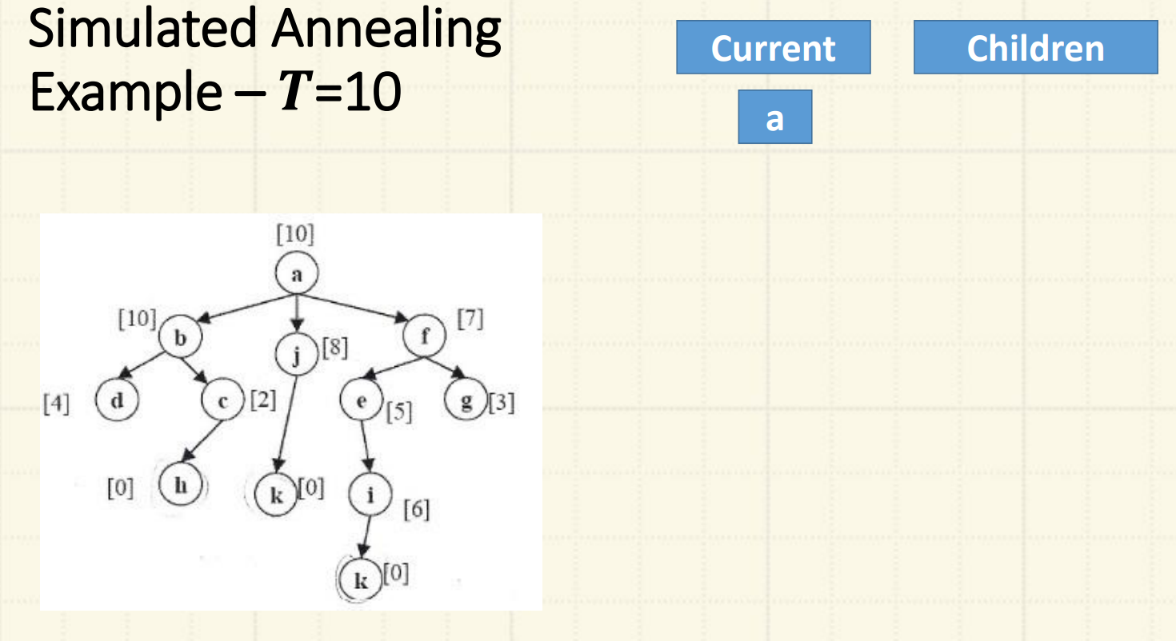
Example

Slide 43
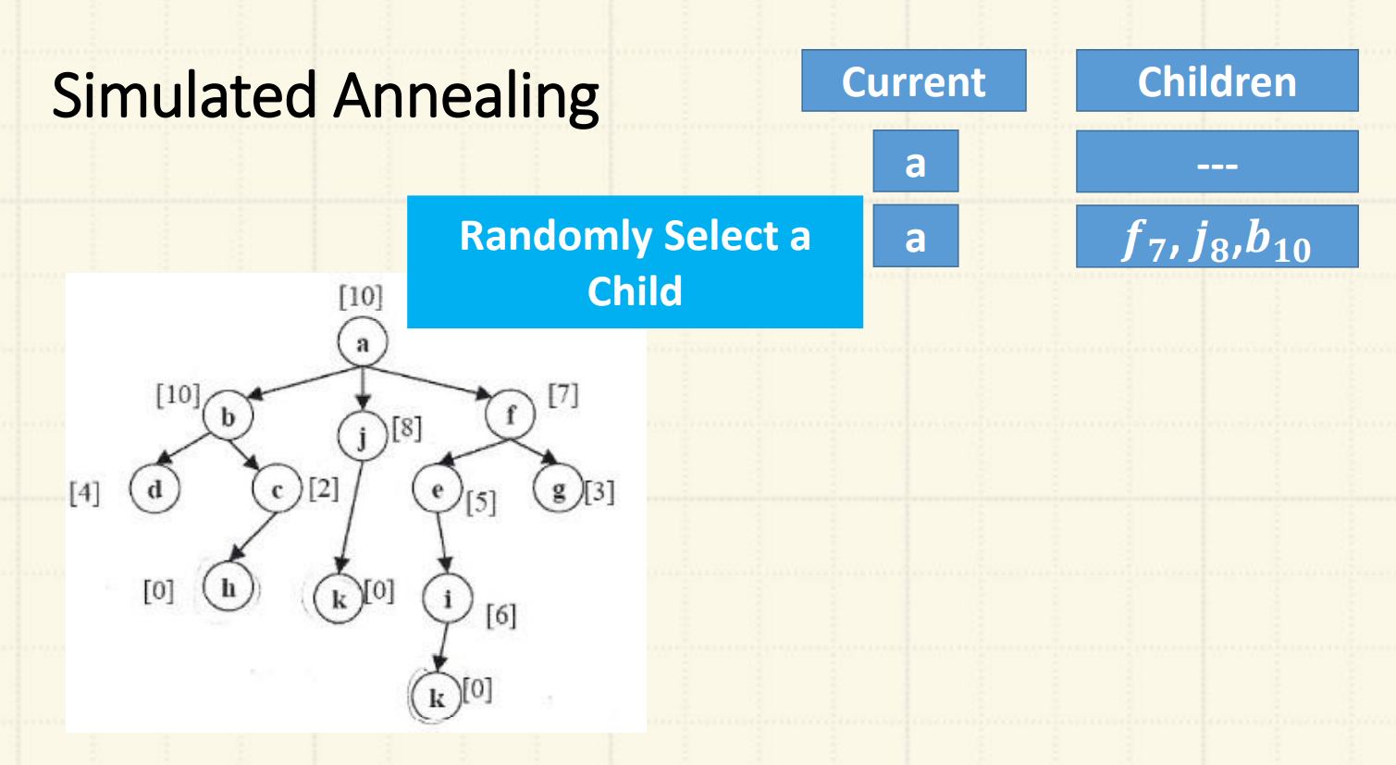

Slide 44
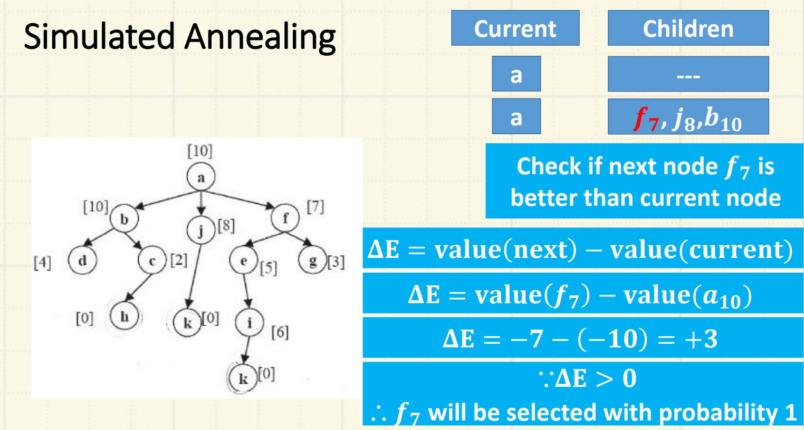

Slide 45
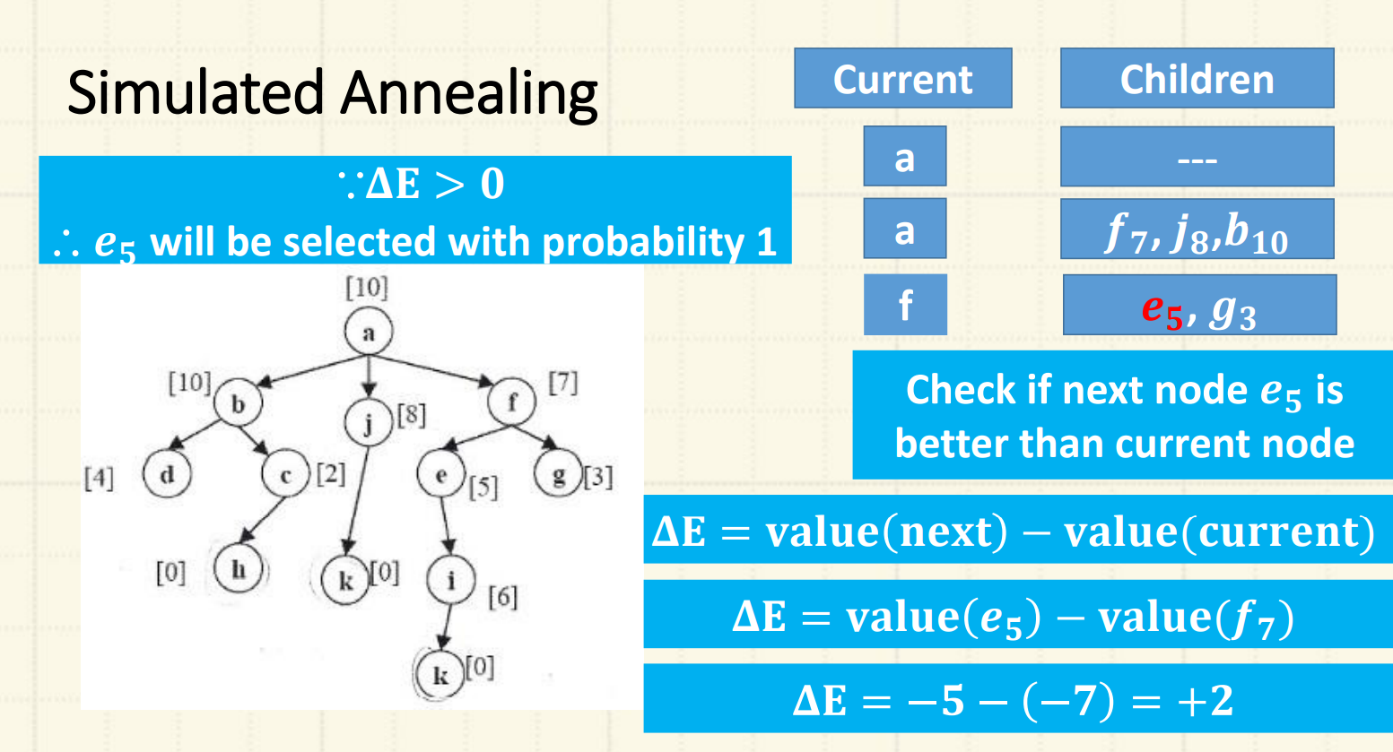

Slide 46
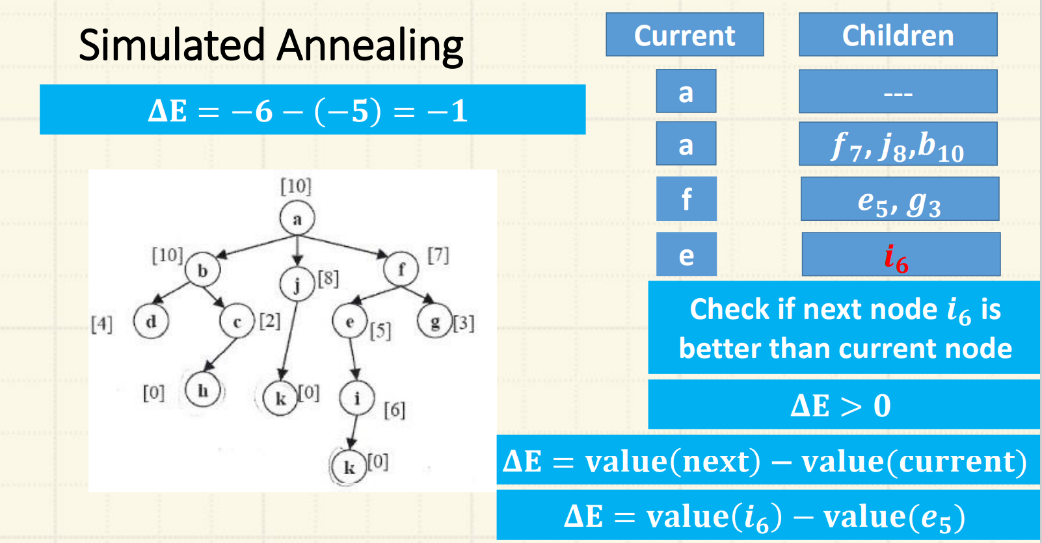

Slide 47
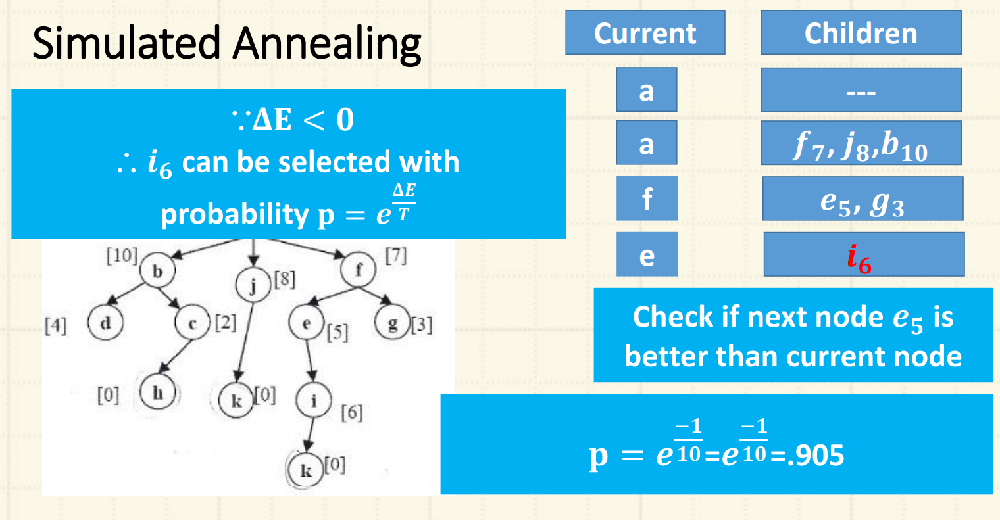

Slide 48
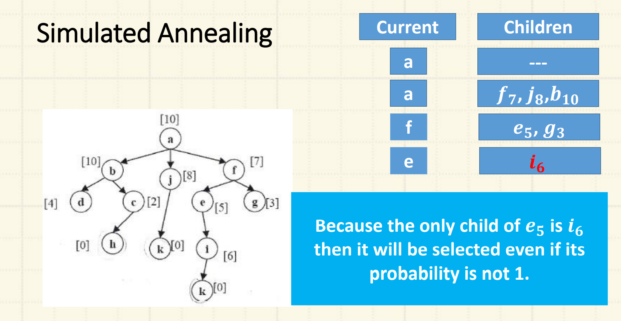

Slide 49
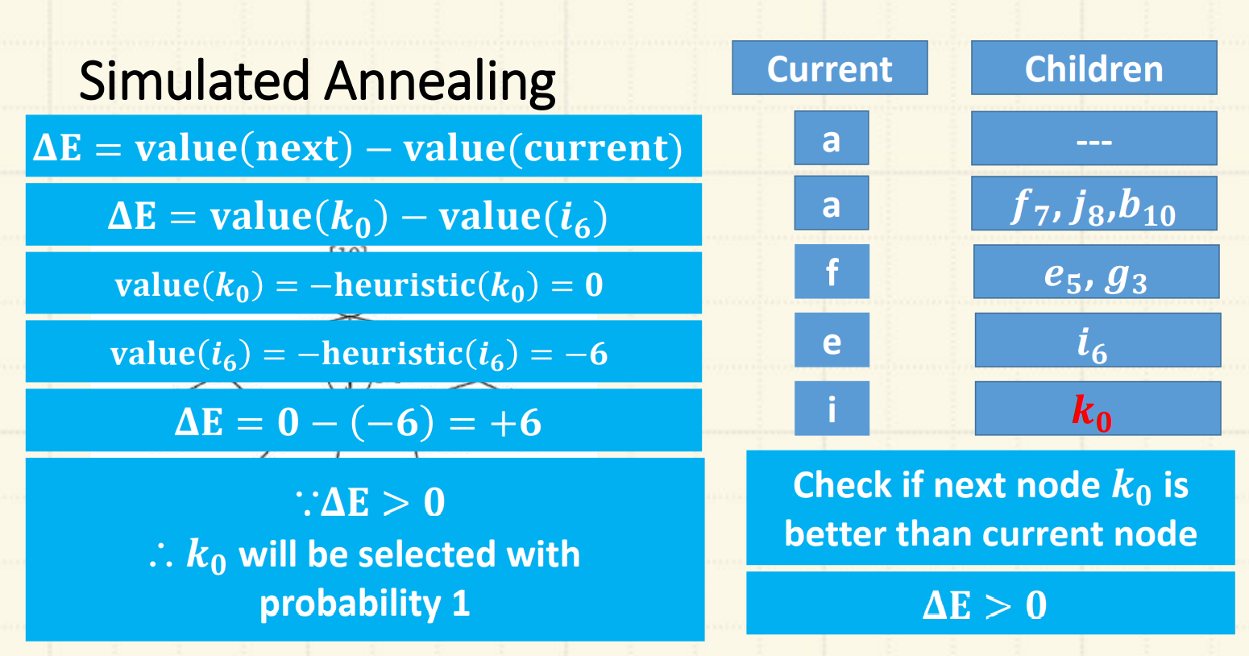

Slide 50
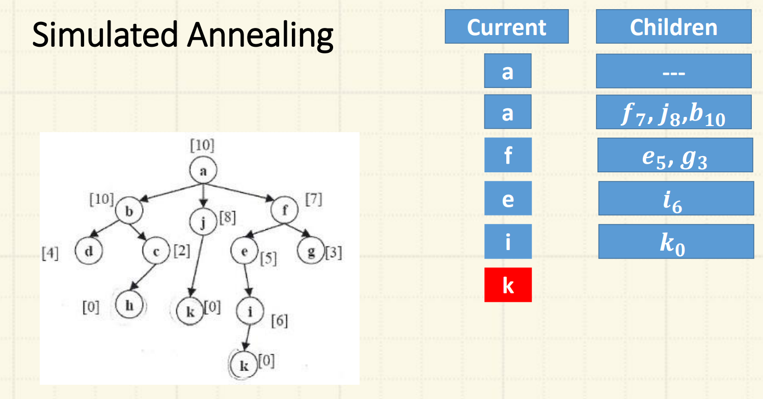

Slide 51
Local Beam Search
Hill Climbing just explores all nodes in one branch until goal found or not being able to explore more nodes.
Beam search explores more than one path together. A factor K is used to determine the number of branches explored at a time.
If k=2, then two branches are explored at a time.
if k=4, four branches are explored simultaneously.
The branches are best branches based on the used heuristic evaluation function.

Slide 52
Local beam Search
Keep track of k states rather than just one
Start with k randomly generated states
At each iteration, all the successors of all k states are generated
If any one is a goal state, stop; else select the k best successors from the complete list and repeat.
Beam search is useful where k can be selected depending on the memory available.
The parallel search of beam search leads quickly to abandoning unfruitful states and moves rapidly towards the goal state.

Slide 53
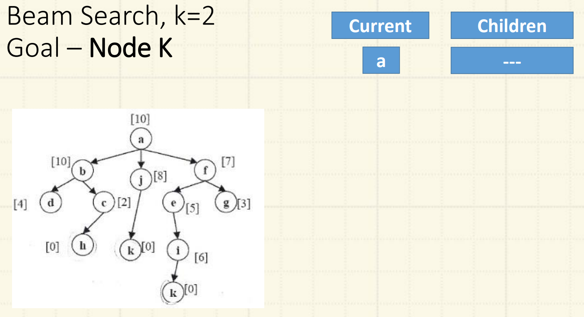
Example

Slide 54
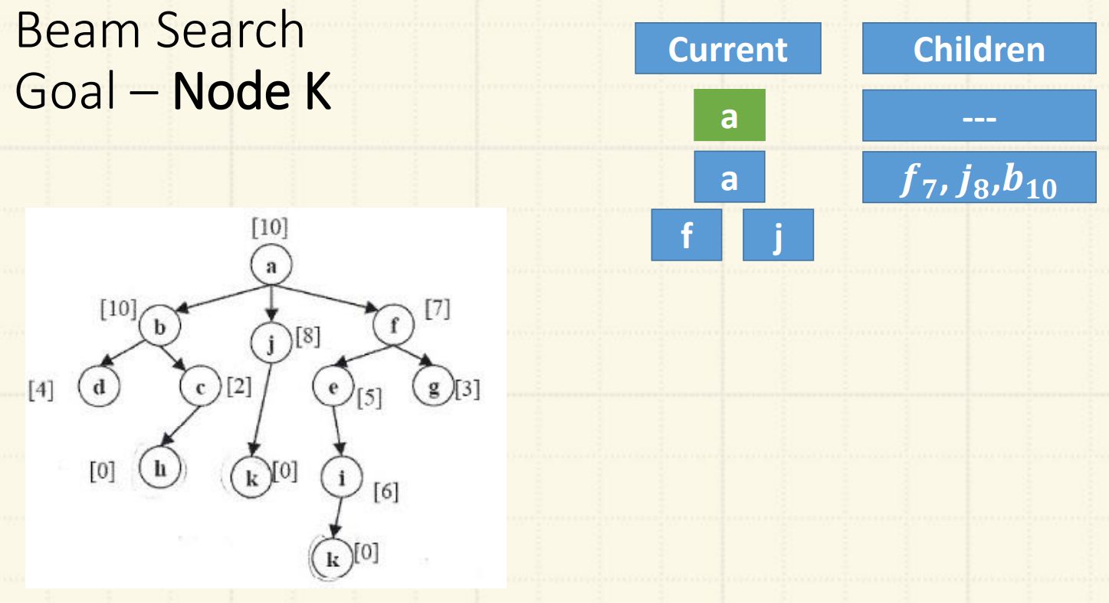

Slide 55
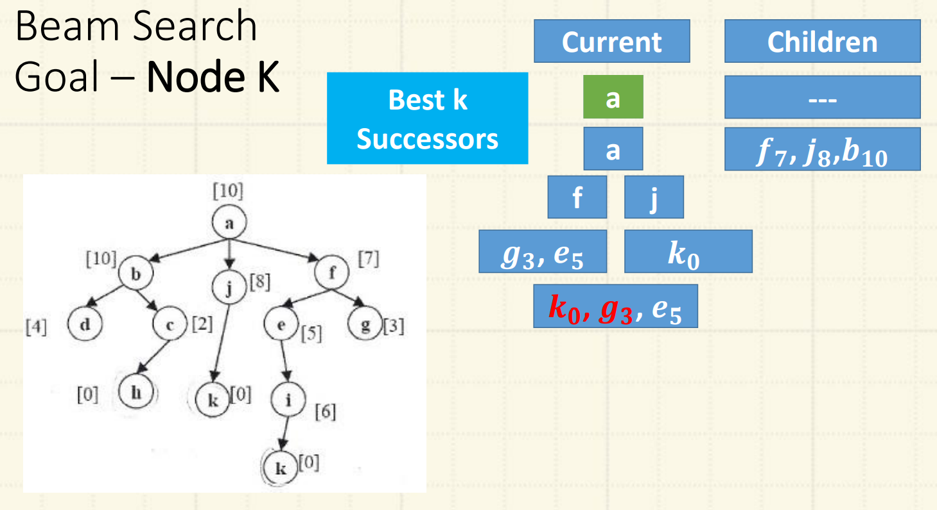

Slide 56
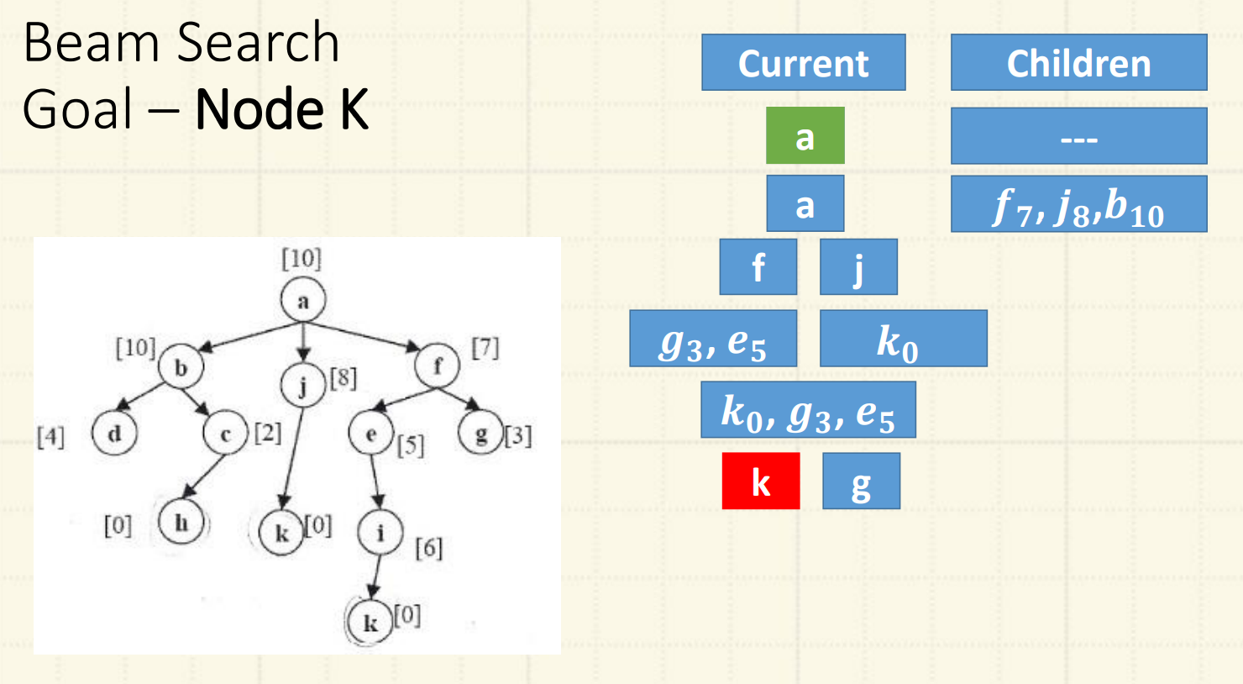

Slide 57
Reading Reference
The content of this lecture comprise of material from Chapter 4 of the course book.

